Slide 1

How to make bumper video using Inkscape and Synfig
Muhammad Irfan
Irfan.pule2@gmail.com
Notes:
Inggris
Hello guys, welcome to the openSUSE Asia Summit 2016 in the city of Yogyakarta, Indonesia.
Thanks to the organizers, participants and speakers who are present here.
My name is muhammad irfan. I from GLiB Bogor.
I am very happy to get the chance of lighting talk about How to make video bumper openSUSE using Inkscape and Synfig.

Slide 2
Muhammad Irfan a.k.a (irfan pule)
GNU/Linux Bogor @GLiBogor
Web Developer at iLab
Freelance Graphic Designer

Slide 3
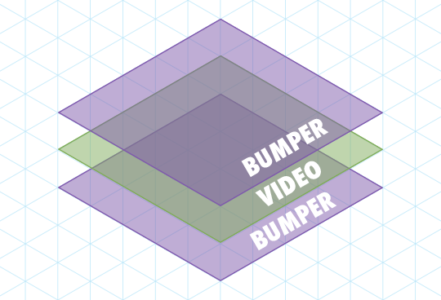
Apa itu bumper video ?
In the United Kingdom, a break-bumper is a brief appearance of a logo before or after advertising breaks, usually that of the television channel being watched.
https://en.wikipedia.org/wiki/Bumper_(broadcasting)

Slide 4
Apa itu bumper video ?
Bumper video biasanya digunakan untuk pembuka dan penutup pada sebuah video, contoh :
Tutorial
Presentasi
Teaser
Review
dll
Notes:
Jelaskan sedikit tentang fungsi bumper !
Inggris
Bumper video gives the identity of your video, so that the audience could identify.

Slide 5



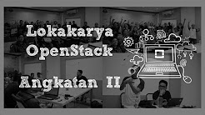
Contoh bumper video
https://www.youtube.com/watch?v=J4MkT_NgcQ8
https://www.youtube.com/watch?v=URAOzCRirEE
https://www.youtube.com/watch?v=fJCEdleThbg
https://www.youtube.com/watch?v=bfdRqn2u5-g

Slide 6



Bagaimana membuatnya ?
Save As
Render
Inkscape Project
.svg
Synfig Project
.sif or .sifz
Bumper Video
.mp4
Notes:
I make it using Inkscape, inkscape as a tool to layout and drawing. Why I use it ?
because synfig is to difficult for me.
So, for those of you who are used Inkscape, you can directly learn animation in Synfig
After that I save as to the .sif file to animate in Synfig.
Then when you're done, I render video files to .mp4

Slide 7
Synfig Studio
Synfig Studio is a free and open-source 2D animation software, designed as powerful industrial-strength solution for creating film-quality animation using a vector and bitmap artwork. It eliminates the need to create animation frame-by frame, allowing you to produce 2D animation of a higher quality with fewer people and resources. Synfig Studio is available for Windows, Linux and MacOS X.
Sumber : http://www.synfig.org/cms/

Slide 8
Inkscape
Inkscape is professional quality vector graphics software which runs on Windows, Mac OS X and GNU/Linux. It is used by design professionals and hobbyists worldwide, for creating a wide variety of graphics such as illustrations, icons, logos, diagrams, maps and web graphics. Inkscape uses the W3C open standard SVG (Scalable Vector Graphics) as its native format, and is free and open-source software.
Sumber : https://inkscape.org/en/about/

Slide 9
Pemasangan
Synfig
Inkscape
http://www.synfig.org/cms/en/download/
https://inkscape.org/en/download/

Slide 10
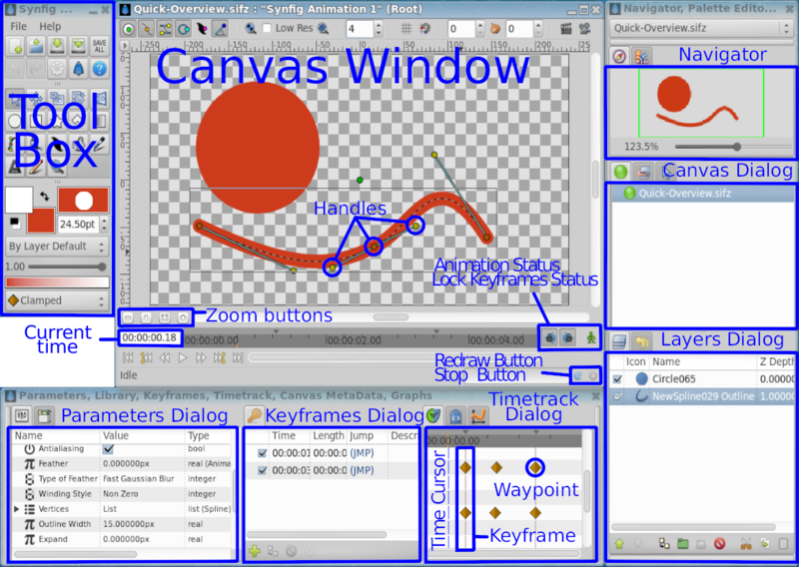
Antarmuka Synfig
Sumber : http://wiki.synfig.org/Doc:Quick_Overview

Slide 11
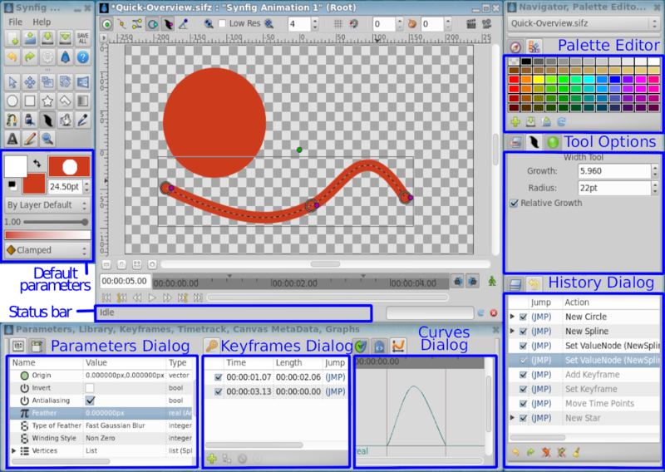
Antarmuka Synfig
Sumber : http://wiki.synfig.org/Doc:Quick_Overview

Slide 12

Latihan 1
Transformation
Masking

Slide 13
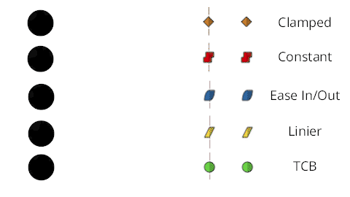
Perbedaan Waypoint

Slide 14
Latihan 2
Membuat bumper video sederhana
Url git
Buka file .svg menggunakan Inkscape
Pengelompokan objek pada layer
Save as file ke .sif
Notes:
This is the example

Slide 15
Latihan 3
Membuat bumper video sederhana
Buka file .sif
Penganimasian
Rendering (.mp4)
Notes:
This is the example

Slide 16
Info selengkapnya
http://youtube.com/irfanpule13
Irfan.pule2@gmail.com
http://facebook.com/irfanpule
http://github.com/irfanpule/bumper-video-openSUSE
Notes:
you can visit my youtube channel to get more detailed tutorial.
You can ask me via email or facebook messenger or comment on youtube.
if you want to get this project, you can fork my repository in github.
the last, I would replay my bumper video

Slide 17
Terima kasih

